Slide 1




Predicting Survival Time of LGG Patients: Refining Feature Selection Methods
Mackenzie M., Neo K., Rosie D., Sanchayan B.

Slide 2
Goals
Compare different feature selection techniques to identify the one that yields the lowest Root Mean Squared Error (RMSE) in predicting survival time
Develop a model that can be effectively generalized to newer data, mitigating the risk of overfitting and ensuring robust performance
Address multicollinearity issues in the dataset by implementing appropriate methods to manage and control the impact of highly correlated predictor variables
Notes:
RMSE: measures difference between predicted outcomes and actual observed outcomes

Slide 3
Pipeline of Project
Data
Feature Selection
Transformation
Linear Model
Tests
Genomics
Imaging
Random Forests
Box-Cox
Ridge Regression
RMSE
Boruta
Linear Model (LM)
Bagged Trees
Stability Selection
Robustness
LASSO

Slide 4
Pipeline of Project
Data
Feature Selection
Transformation
Linear Model
Tests
Genomics
Imaging
Random Forests
Box-Cox
Ridge Regression
RMSE
Boruta
LM
Bagged Trees
Stability Selection
Robustness
LASSO
Notes:
We use Genomics and Imaging separately to construct models

Slide 5
Splitting Data
Data
Train Data
80%
To build the model
Test Data
20%
To evaluate model performance
Notes:
Essential to evaluate model performance
Generalizability & prevent overfitting
Our split ratio for this was 80% and 20%, where the training set would be used to build our models, while the test set would remain untouched until our final evaluation
With model predictions, compared using out of sample RMSE

Slide 6
Pipeline of Project
Data
Feature Selection
Transformation
Linear Model
Tests
Genomics
Imaging
Random Forests
Box-Cox
Ridge Regression
RMSE
Boruta
LM
Bagged Trees
Stability Selection
Robustness
LASSO

Slide 7
Feature Selection Methods
LASSO
Recursive Feature Elimination
Random Forests
LM
Bagged Trees
Boruta

Slide 8
Feature Selection Methods
LASSO
Recursive Feature Elimination
Random Forests
LM
Bagged Trees
Linear regression method that adds penalty term to the loss function to encourage sparsity, resulting in feature selection.
Boruta
Notes:
In lasso we add a penalty term to the loss function. This controls the sum of the magnitude of coefficients. It forces some of the coefficients to be zero, resulting in feature selection.

Slide 9
Feature Selection Methods
LASSO
Recursive Feature Elimination
Random Forests
LM
Bagged Trees
Boruta
Identifies important variables by comparing importance of original features with that of shadow variables which are random permutation of the original feature
Kursa, M. B., & Rudnicki, W. R. (2010). Feature Selection with the Boruta Package. Journal of Statistical Software, 36(11),
Notes:
Boruta takes feature columns and randomly permutes the column and it calls them shadow features. It checks whether the feature is better than the shadow feature. If the shadow feature is better than it rejects else keeps it.

Slide 10
Feature Selection Methods
Recursive Feature Elimination
Random Forests
LM
Bagged Trees
Recursively removes less important features from a model to improve its performance and reduce overfitting

Slide 11
Feature Selection Methods
Recursive Feature Elimination
Random Forests
LM
Bagged Trees
Recursively removes less important features from a model to improve its performance and reduce overfitting
Removes features that increase mean error of random forest regressor
Orders according to magnitude of coefficients of features
Removes features that increase mean error of the bagging
Notes:
Recursive Feature Elimination is type of backward selection which removes less important features by training the model and ranking using variable importance. Here are the few models that we try out, Random Forests, Linear Model and Bagged Trees.

Slide 12
Pipeline of Project
Data
Feature Selection
Transformation
Linear Model
Tests
Genomics
Imaging
Random Forests
Box-Cox
Ridge Regression
RMSE
Boruta
LM
Bagged Trees
Stability Selection
Robustness
LASSO

Slide 13
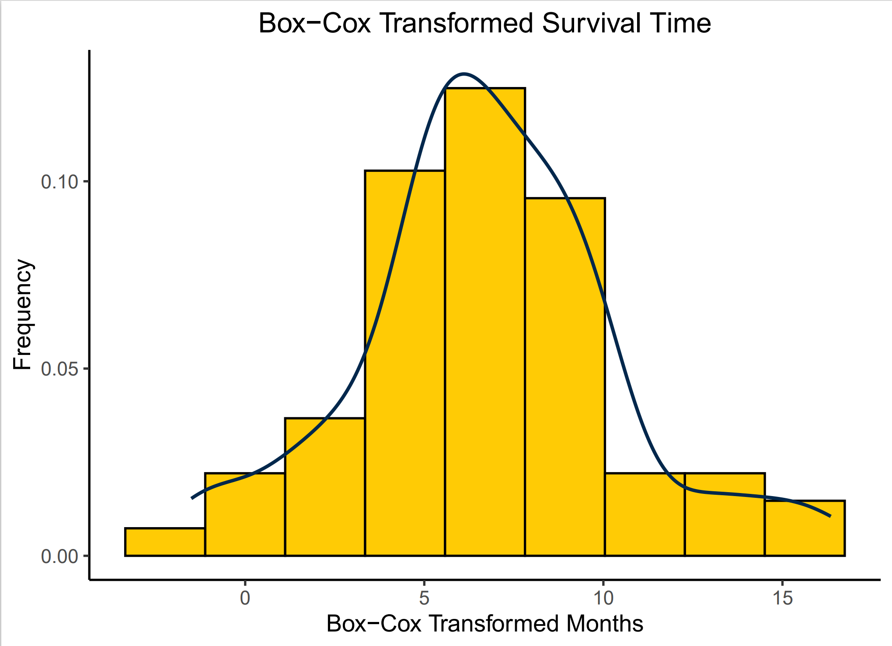
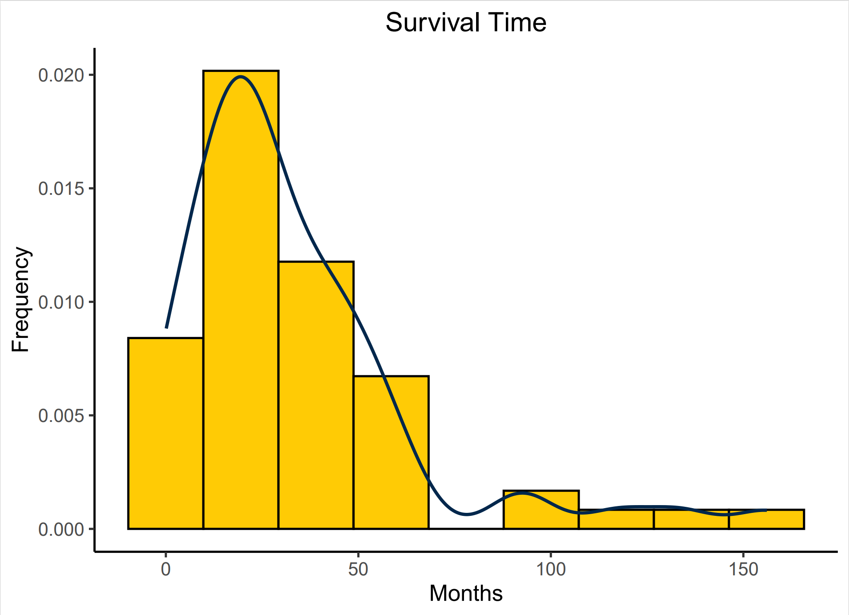
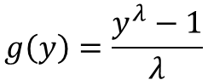
Survival Time Transformation
$$g\left(y\right)=\frac{y^{λ}−1}{λ}$$

Slide 14
Pipeline of Project
Data
Feature Selection
Transformation
Linear Model
Tests
Genomics
Imaging
Random Forests
Box-Cox
Ridge Regression
RMSE
Boruta
LM
Bagged Trees
Stability Selection
Robustness
LASSO

Slide 15
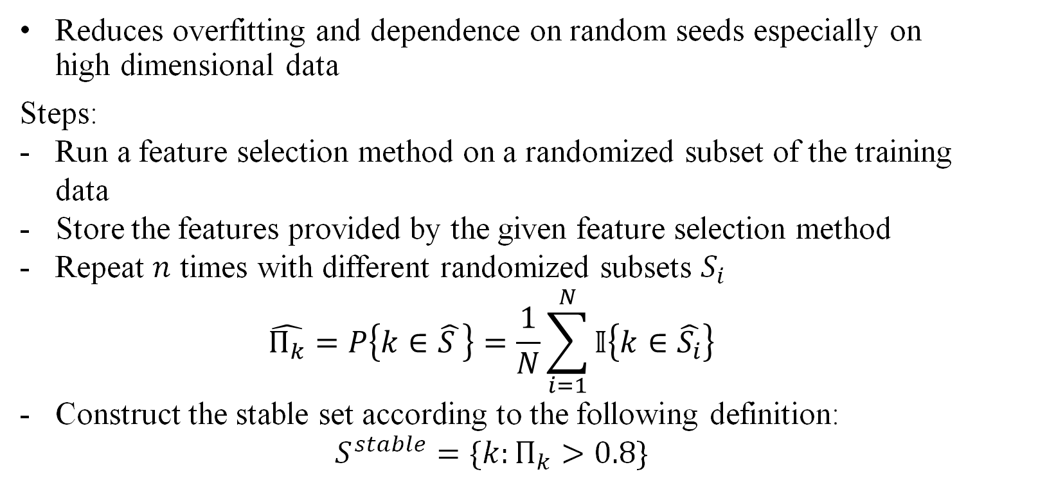
Stability Selection
Reduces overfitting and dependence on random seeds especially on high dimensional data
Steps:
Run a feature selection method on a randomized subset of the training data
Store the features provided by the given feature selection method
Repeat $n$ times with different randomized subsets $S_{i}$
$$\hat{Π_{k}}=P\left\{k∈\hat{S }\right\}=\frac{1}{N}\sum_{i=1}^{N}{𝕀\left\{k∈\hat{S_{i}}\right\}}$$
Construct the stable set according to the following definition:
$$S^{stable}=\{k:Π_{k}>0.8\}$$
Meinshausen, N., & Bühlmann, P. (2010). Stability selection. Journal of the Royal Statistical Society Series B: Statistical Methodology, 72(4), 417-473.
Notes:
Performed a technique called stability selection
This process works by taking a randomized subset of the training sets, running our feature selection methods on the subset, then extracting the variables that the feature selection method identifies most important, and storing those. Repeat this N times with different randomized subsets of the training set. Look at how often each variable shows up, taking top 20% to create final model
We utilized stability selection to reduce overfitting and the dependence of results on random seeds

Slide 16
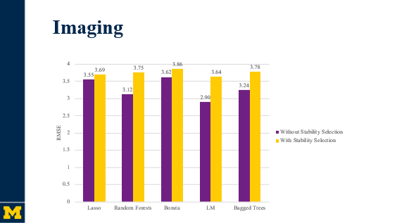
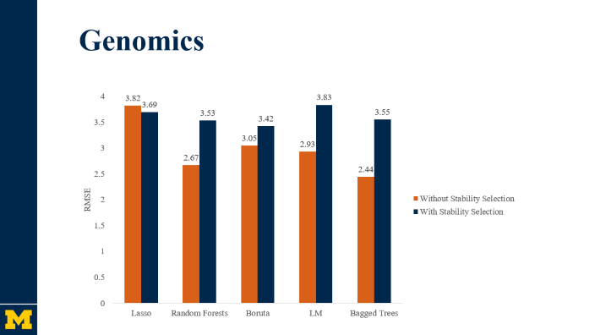
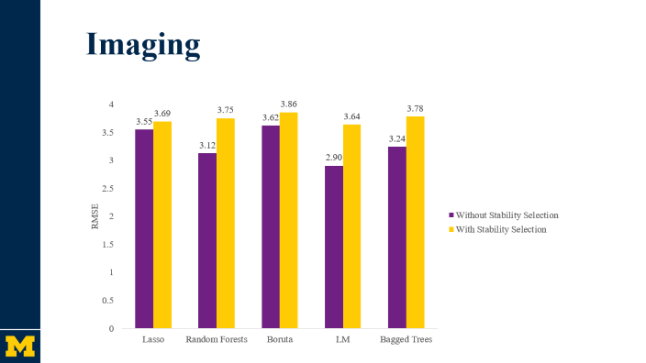
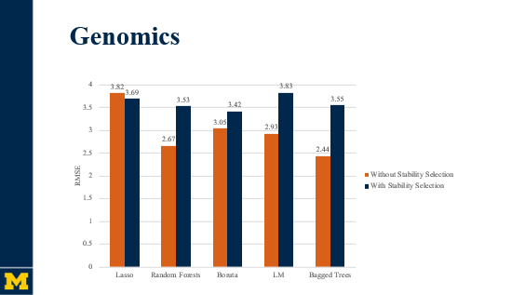
Effect of Stability Selection
Notes:
We kept changing our seed and running the feature selections multiple times; seeing different results
Depended on random seed & susceptible to overfitting
Wanted research to be reproducible

Slide 17
Genomics
Notes:
Looking at RMSE -> models technically performing worse, but we have higher confidence in predictive capabilities of stability selection
Lasso has consistent performance
Bagged trees outperformed random forest w/o stability selection (but paper by Leo Breiman said rf should generally perform better)
Bagged trees performing better came from the fact that our sample size is small

Slide 18
Genomics
Breiman, L. (2001). Random forests. Machine learning, 45, 5-32.
Notes:
With stability selection random forests are performing better with the lower RMSE

Slide 19
Imaging
Notes:
Similar things with imaging data
Lasso consistent, rf performing better than bagged trees

Slide 20
Pipeline of Project
Data
Feature Selection
Transformation
Linear Model
Tests
Genomics
Imaging
Random Forests
Box-Cox
Ridge Regression
RMSE
Boruta
LM
Bagged Trees
Stability Selection
Robustness
LASSO
Notes:
Coming to addressing multicollinearity

Slide 21
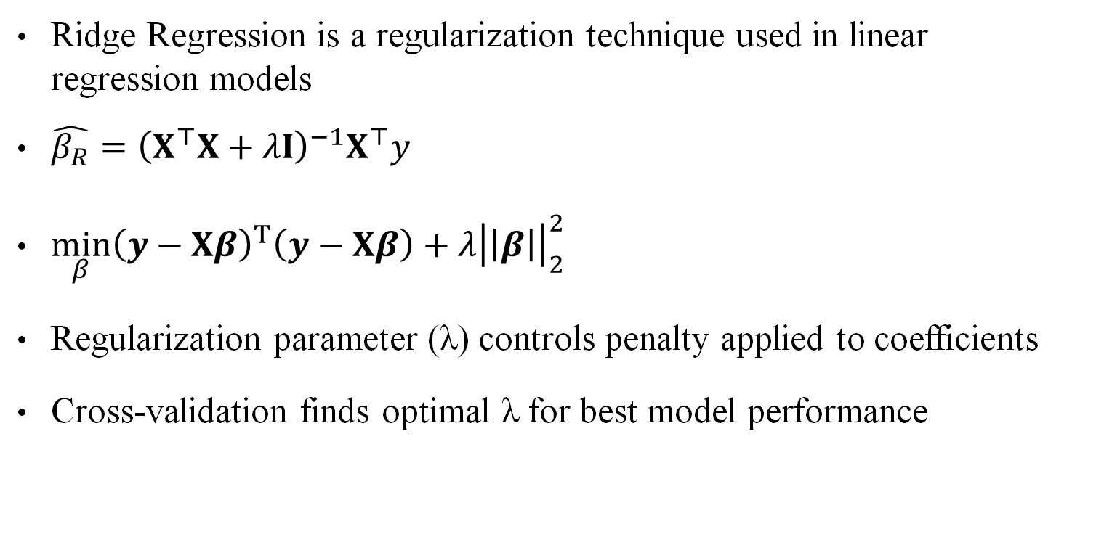
Ridge Regression
Ridge Regression is a regularization technique used in linear regression models
$\hat{β_{R}}={\left(X^{⊤}X+λI\right)}^{−1}X^{⊤}y$
$\min_{β}{\left(y−Xβ\right)}^{T}\left(y−Xβ\right)+λ{\left|\left|β\right|\right|}_{2}^{2}$
Regularization parameter (λ) controls penalty applied to coefficients
Cross-validation finds optimal λ for best model performance
Notes:
Ridge Regression is like linear regression but there is this lambda I being added. This lambda regularizes the model, that is it forces the coefficients to be small. It is a penalty factor. So, the loss function is the loss function of linear function along with this additional term. The optimal lambda is then found using cross validation.

Slide 22
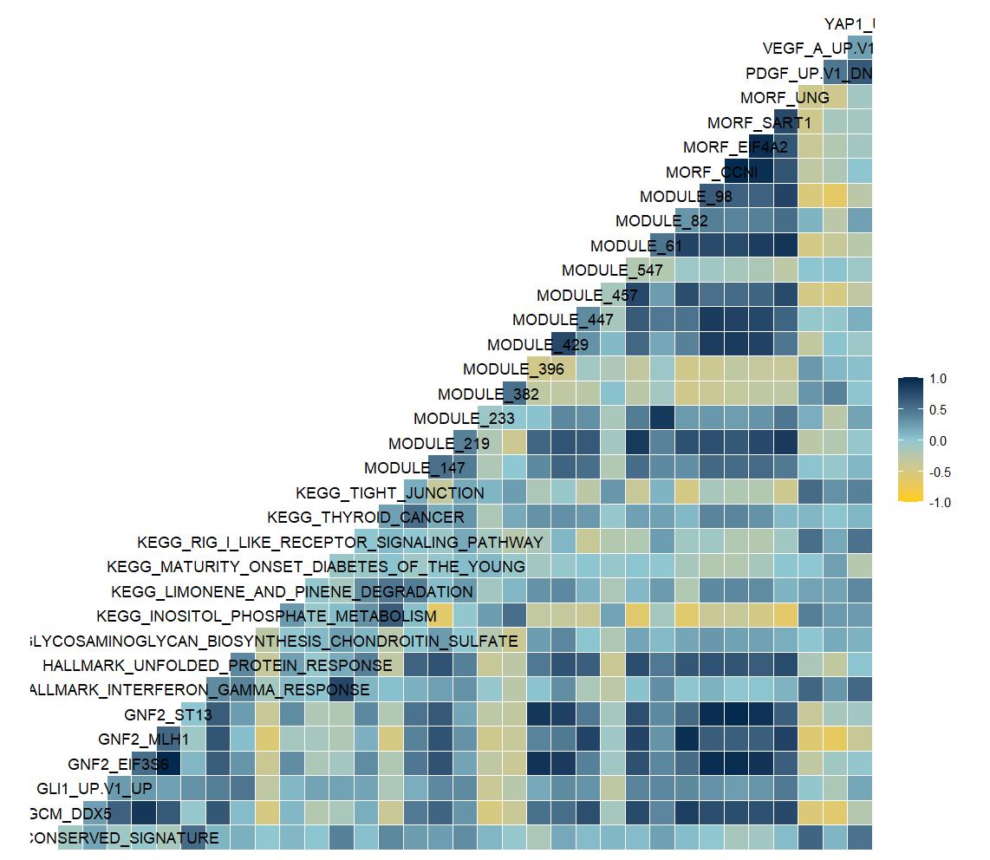
Why Ridge?
Reduces impact of multicollinearity on model
Prevents over-fitting

Slide 23
Pipeline of Project
Data
Feature Selection
Transformation
Linear Model
Tests
Genomics
Imaging
Random Forests
Box-Cox
Ridge Regression
RMSE
Boruta
LM
Bagged Trees
Stability Selection
Robustness
LASSO

Slide 24
RMSE of Feature Selection Methods
Notes:
Here you can see the root mean squared error of the models when fitted to our test data.
Boruta performs the best overall when applied to the genomics data
Lasso performs the best on imaging
How can we interpret these results?

Slide 25
RMSE of Feature Selection Methods
Notes:
Boruta performed the best overall with the gene pathway data, but is quite highly variable between datasets compared to others
But, what do these numbers mean? How good is this performance?

Slide 26
RMSE of Feature Selection Methods
Notes:
Boruta performed the best overall with the gene pathway data

Slide 27
RMSE of Feature Selection Methods
3.8

Slide 28

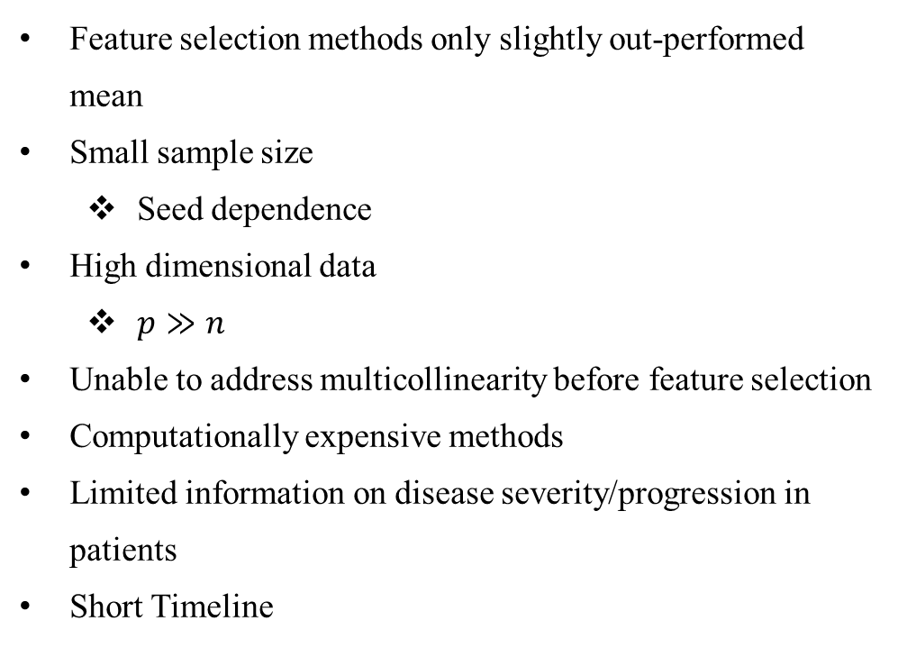
Limitations
Feature selection methods only slightly out-performed mean
Small sample size
Seed dependence
High dimensional data
$p≫n$
Unable to address multicollinearity before feature selection
Computationally expensive methods
Limited information on disease severity/progression in patients
Short Timeline
Notes:
Multicollinear before feature selection – can cause issues with how the methods select the data (some feature selection methods don't address it as well)
Collinearity is fine post-feature selection since we use ridge
However, after doing feature selection methods we used ridge to address some issues of multicollinearity

Slide 29

Key Takeaways
Boruta method performed best overall with genomic data, but was highly variable between datasets
RMSE of 3.42
LASSO is very consistent
0.13 RMSE difference between pre-and post-stability models
Stability selection effectively ensures reliability and robustness
Reduces the impact of dependency on randomness, especially for low n
High dimensional data is very difficult to work with
Notes:
Don't have to explicitly say the "RMSE of 3.42" and bullet point of LASSO
Should say something like: Lasso is very consistent, which would explain why it is so commonly used in statistical applications

